Slide 1
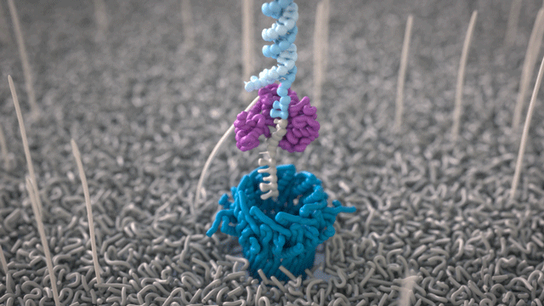

There’s More to Nanopore
Luke Ames
Senior Research Technician & PhD Student
Andrew Beggs Lab, University of Birmingham

Slide 2
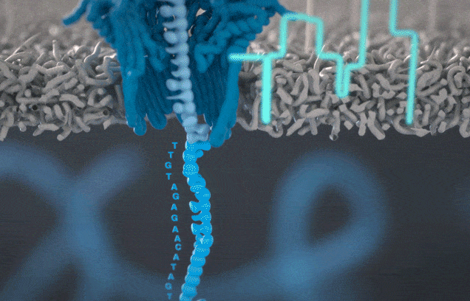
What is nanopore sequencing?
ONT sequencing utilizes protein nanopores embedded in a membrane.
Using motor proteins attached to DNA fragments during library preparation, DNA is fed through the protein pore.
As the DNA is fed through, changes to the electrical current across the membrane can be detected.
Each base has its own specific change to the electrical current.
Bioinformatically we can convert these electrical changes into a readable DNA sequence.
Notes:
The membrane is given a positive charge during sequencing to help attract DNA which is negatively charged.
The motor protein is a DNA helicase which unwinds the double stranded DNA and allows a single strand to be fed through the pore.
The conversion of electrical changes into DNA sequences is called base calling.

Slide 3
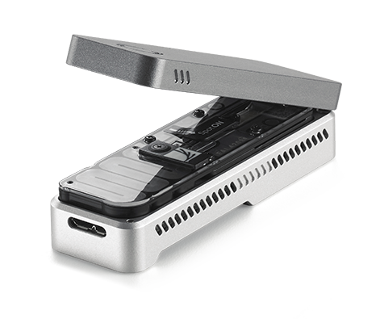
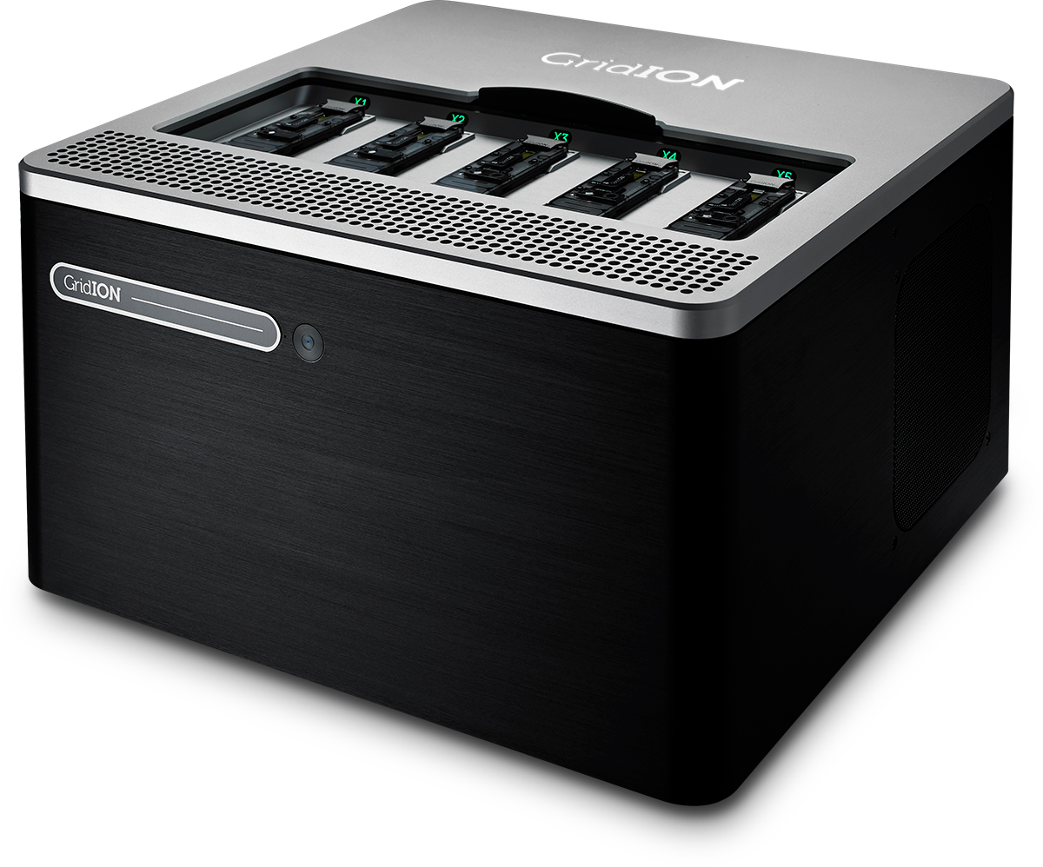
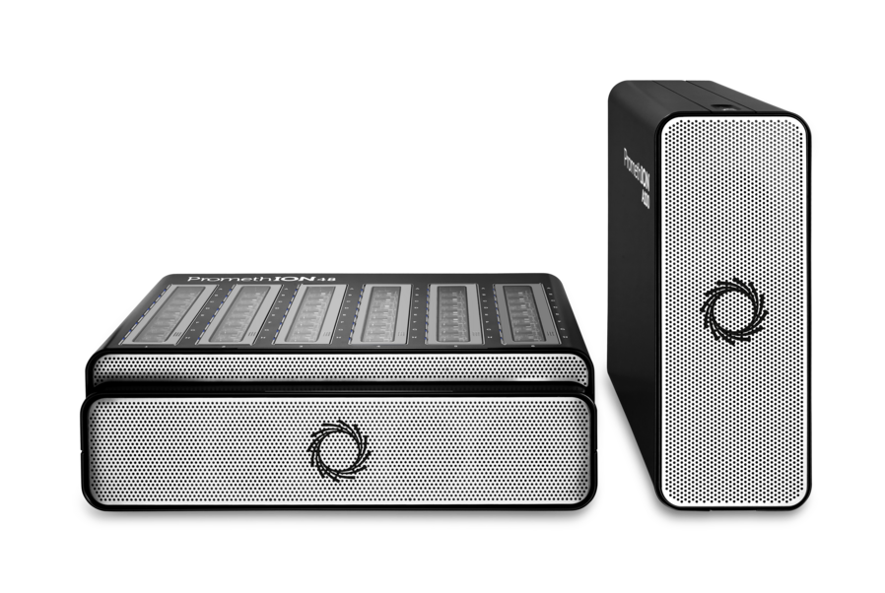
Scalability of ONT
MinION
Portable single flow cell device which plugs in via USB
GridION
Benchtop sequencer which fits 5 flow cells at once
PromethION
Largest sequencer which can fits up to 24 flow cells at once
Notes:
Minion
Uses minion flow cells which contain up to 1500 pores.
Portable device which can be used on the go. Talk about example of lab using this in Peru jungle to monitor diseases carried by mosquitoes.
Also used on ISS…
Gridion
Larger sequencer which can sequence up to 5 minion flow cells at a time
Promethion
Biggest sequencer currently commercially available
Uses specific promethion flow cells which contain up to 10000 pores each
You can sequence up to 24 flow cells at once on the 24 unit, and 48 on the 48 unit

Slide 4
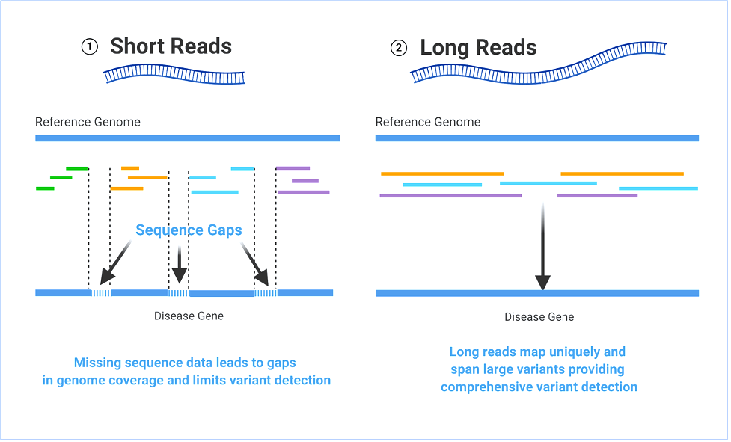
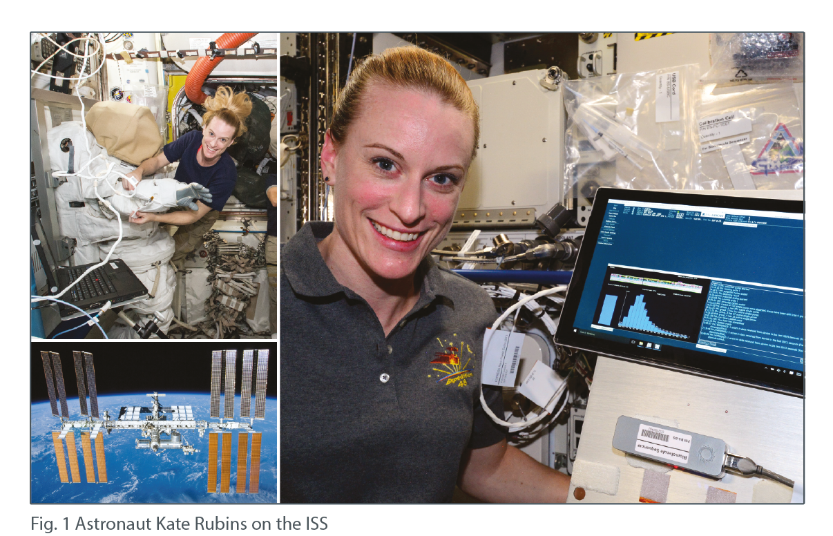
The perks on ONT
It’s quick to prepare.
Uses native DNA as an input.
You’re able to multiplex samples together.
You can select specific targets to observe.
Data can be analysed during sequencing.
Cost effective and flow cells can be reused.
Longer reads make it easier to spot changes in the genome.
MinION sequencers are portable.
Notes:
Most library prep methods can be completed in a morning, and you can have your sample loaded onto the sequencer by the end of the day
As there is no amplification steps in the standard protocols, you maintain the methylation pattern on DNA which can be detected
Much like other sequencing methods, you’re able to barcode samples and then pool together into one library. This can be a cost effective way of getting the most data for your money
Using adaptive sampling, you can input genes/chromosomal regions you wish to be sequenced. Anything which doesn’t align with your targets will be removed from the pore and not sequenced.
ONT utilizes live sequencing, allowing you to begin to analyse your data whilst the sequencing run is still active
£300 a genome as you can get 2x whole genome on a good prom run. Previously used flow cells can be enzymatically washed, allowing you to load a new library and sequence. This can be very cost effective.
Conventional short read methods require you to chop up samples to a few hundred bp in length. This may result in changes such as indels and SNVs to be missed. Longer reads help us to see a clearer picture of the genomes structure and allow us to spot these changes that may be missed using short read methods

Slide 5
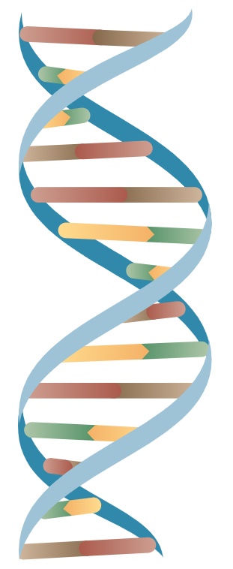
What kind of information can you obtain?
Single base changes – insertion, deletions, and base changes
Haplotype phasing –
mapping genomic changes to specific alleles
Structural changes –
genomic inversions, translocations, repeat regions, and gene region deletions
Methylation patterns – detection of methylation
Notes:
Haplotype phasing can be used to distinguish between maternal or paternal homologs.
Methylation on cytosine (5 methyl and 5 hydroxymethyl) and adenosine (6 methyl). Observe epigenetic marks typical of gene suppression. Big this up and say how we can get this from native DNA and don’t need to perform any modifications during the library prep, i.e. bisulfide conversion. All this requires is a higher accuracy with basecalling to see the electrical changes between normal and methylated bases.

Slide 6
Types of ONT inputs
Short read fragments
Below 1kb in length
Long read fragments
Commonly between 10 to 100kb
Ultra high molecular weight
Exceeding 100kb in length

Slide 7
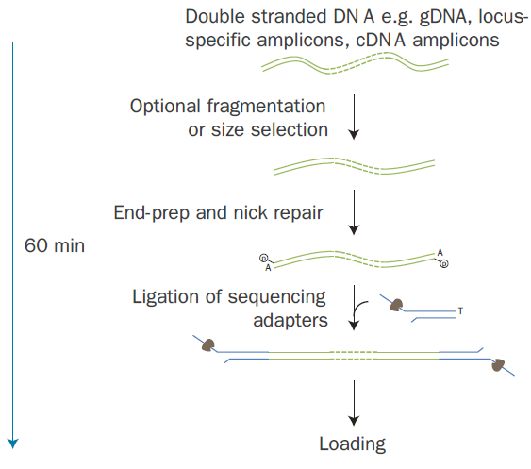
Long read sequencing
The most commonly used method which involves end repairing samples and ligating on a sequencing adapter.
Input DNA can be sourced from a wide range of sample types.
Samples can be sheared to help improve sequencing capacity.
You’re able to barcode samples to multiplex into one library.
Notes:
Such examples include cultured cells, primary tissue samples, and blood. Talk about project which used sorted cell population from patient blood samples.
Really long fragments can potentially block pores and stop them from sequencing. Shearing to 10-20kb may improve the data output
As mentioned before, barcoding can help reduce costs, but will come at the expense of reduced data per sample
We aim for approximately 90gb of data per sample, which equates to 30x coverage across the genome

Slide 8
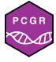
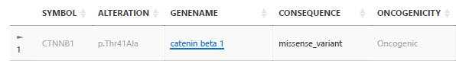
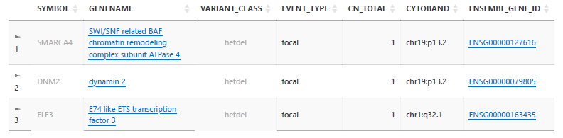
How can we use long read data in the NHS?
Using ONT data, we can use the sequencing outputs to generate clinical reports for a full analysis of the patient.
For example, the Personal Cancer Genome Reporter (PGCR) can give information into oncogenic mutations.
Recently, I sequenced gDNA extracted from a desmoid tumour. Using PGCR, we were able to observe the key mutations the patient presented.
Notes:
We can use reporters to characterise tumours and observe the driver mutations, as well as any other potentially important mutations. This may allow for a more tailored approach to treating patients, and allow clinicians to separate out different patients into alternative treatment pathways.
Desmoid tumours are an aggressive form of fibromatosis which can be locally invasive. Commonly driven by mutations to beta catenin and APC.
This patient had the typical mutation to beta catenin. Further mutations observed to such genes as SMARC4A, which is part of the SWI/SNF signalling pathway.

Slide 9
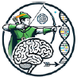

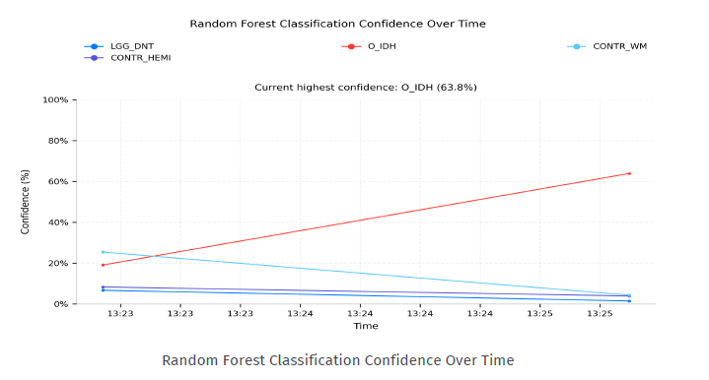
How can we use long read data in the NHS?
Brain tumours can take up to 6 weeks to be diagnosed in the standard NHS pathway.
Different types of brain tumours have signature methylation patterns and using ONT we can use this as a method to classify patients.
Data can be actively fed into a reporter (ROBIN) to begin to classify samples based on methylation results.
Clinical evaluation initially classed this sample as a high-grade tumour, such as a glioblastoma. However, this was in fact an oligodendroglioma.
From surgery to result using ONT can take up to 72 hours.
Project led by Victoria Wykes / Vassili Crispi
Notes:
As ONT sequencing is an “active process”, data can be pulled out whilst the sequencing run is still happening.
This allows for reporting and classification very early on during the sequencing run. As the run continues, there will be more reads generated and result in a higher confidence in classifying the brain tumour.
Oligodendrogliomas are less aggressive and the patient may have a better chance at survival. The results of this reporter could help guide clinicians towards more specific treatment methods depending on the type of tumour.
This is a pilot study, and the results from ONT are used alongside traditional sequencing methods. However, it is hopeful that in the future this method would be the go to way for brain tumour diagnosis.
Using flushed flow cells to reduce costs.

Slide 10
Types of ONT inputs
Short read fragments
Below 1kb in length
Long read fragments
Commonly between 10 to 100kb
Ultra high molecular weight
Exceeding 100kb in length

Slide 11
Short fragmented DNA
Typically, short fragments are below 1kb.
A wide variety of sample types fall into this category, such as PCR amplified DNA and cell-free DNA.
Works in a similar method to traditional long read, however more reads would be required to obtain good coverage across the genome.
So, why would we use short fragments over genomic DNA?
Notes:
Can be as low as ~100bp in length, so can be very similar to Illumina

Slide 12
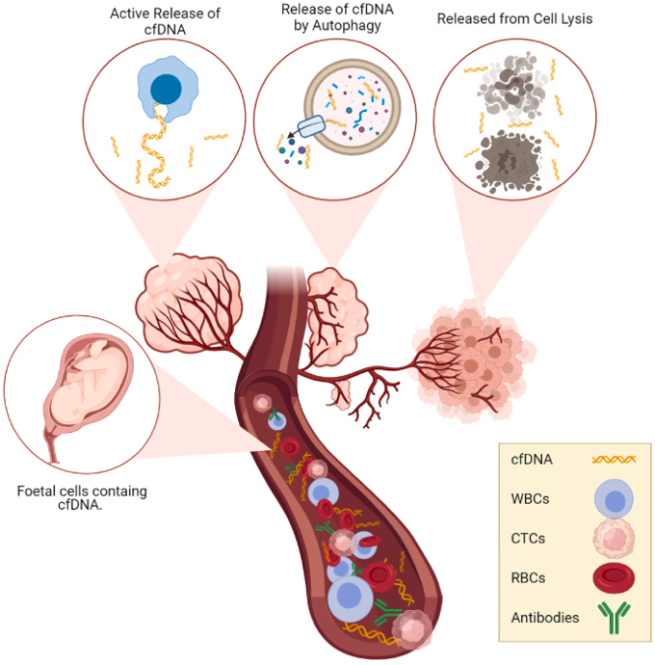
Uses of short reads in the clinical setting
Cell-free DNA is currently a hot topic in the clinical environment.
Use of cfDNA can be a less invasive way to monitor disease progression in patients.
For example, cfDNA can be collected at multiple timepoints across a patient’s treatment to see determine their response.
Potentially, we could be able to catch early if a patient doesn’t respond to a treatment, or if there is relapse, so try an alternative method of treatment.
Notes:
cfDNA can be detected in many bodily fluids, such as plasma in the blood and ocular fluid in the eyes. As cells die off, their cellular contents are released into the local environment.
In many tumours, the cellular turnover rate is high. As a results, tumours can release lots of cfDNA into the body. We can utilise this to monitor diseases in a less invasive manner.

Slide 13
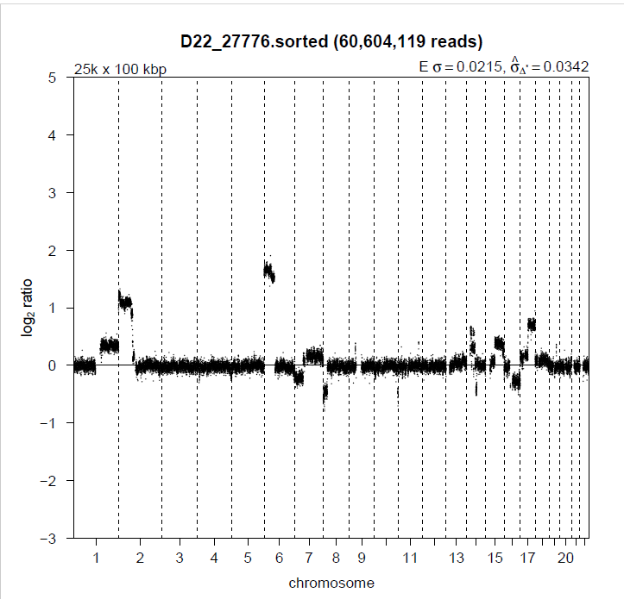
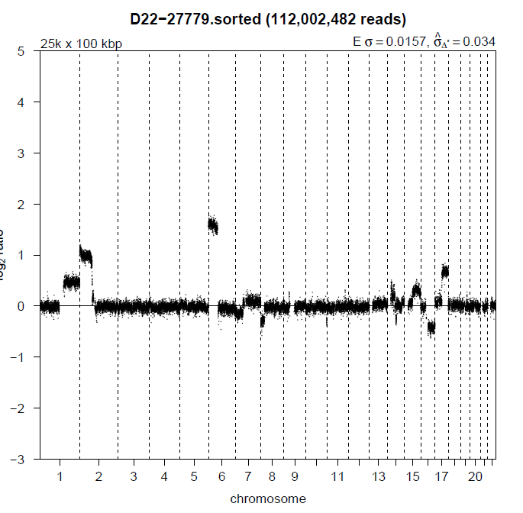
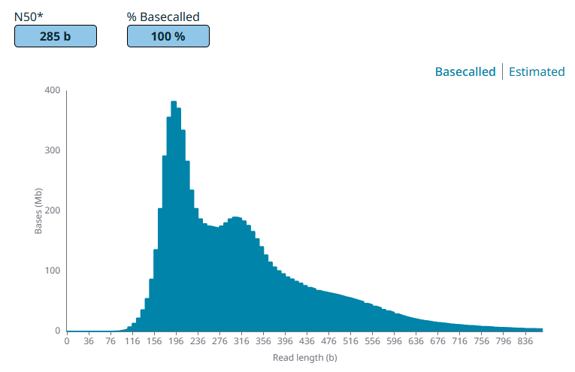
Use of ocular cfDNA to monitor retinoblastoma
tDNA
cfDNA
RB can affect young children and may require eye removal in severe cases.
In ocular fluid, tumour cfDNA can be detected, but could we use this to monitor tumour progression?
Using paired tumour gDNA and ocular fluid cfDNA, we can see mirrored chromosomal signatures.
Further testing required to see how far we can push this test.
Project led by Amy Gerrish / Sam Court
Notes:
If caught early, we can treat RB and save the patient’s eye.
As it’s difficult to monitor disease progression and treatment response, the question was raised if we can detect tumour cfDNA in the ocular fluid.
This patient unfortunately required eye removal, but allowed us to obtain gDNA from the tumour and cfDNA from the ocular fluid.
By sequencing both, we could compare to see how representative of the tumour cfDNA could be. From this patient, we were able to see very similar patterns in copy number variants across the genome.
This suggests we can use ocular fluid as a way to follow tumour progression in child patients, and potentially avoid eye removals.
One limiting factor is the volume of ocular fluid we can obtain, so further testing is required to see how little fluid we can use and still detect tumour cfDNA.

Slide 14
Types of ONT inputs
Short read fragments
Below 1kb in length
Long read fragments
Commonly between 10 to 100kb
Ultra high molecular weight
Exceeding 100kb in length

Slide 15
Ultra high molecular weight DNA
This is the sequencing of really long DNA fragments which can exceed 100kb in length.
Even with conventional long read sequencing, some features of diseases can be missed.
Using ultra high molecular weight DNA we can span huge genomic areas to detect such changes as chromosomal rearrangements and loss or duplication of regions.
This requires a lot of input material, and is mostly used when regular long read sequencing fails to capture these changes.

Slide 16
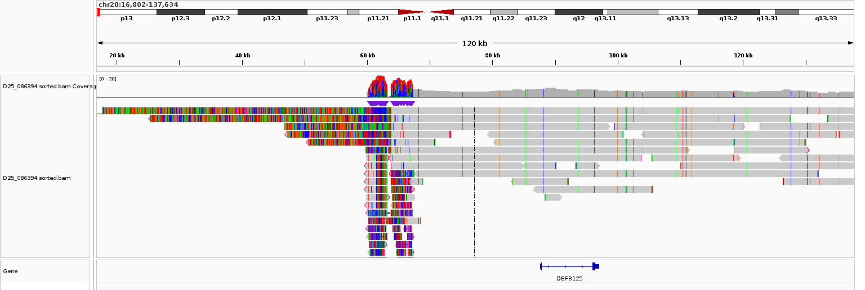
UHMW sequencing and RING20
Ring 20 syndrome is the fusing of the end of chromosome 20 to the start, causing a ring structure.
Using traditional long read sequencing it can be difficult to detect this fusion, so we turned to UHMW methods.
As a result, this fusion could be observed due to super long DNA fragments capturing the fusion point of both end of Chr20.
Project led by Hannah Titheradge
Notes:
Its core feature is drug-resistant (refractory) epilepsy that typically starts in childhood, featuring unique focal seizures often occurring at night, accompanied by cognitive decline and behavioural changes.
The genome browser screenshot shows the start of chromosome 20, but with many reads having a region which extends prior to the start point. When aligned, these regions mapped to the end of chromosome 20, allowing us to detect this ring formation.

Slide 17
Hopefully, I have convinced you that…
Oxford Nanopore sequencing is a very quick technique which provides huge amounts of data
It is a versatile technique which supports a wide range of sample types and lengths
The methodology can be adapted to help answer the question you wish to ask
And, that there’s more to nanopore!
Notes:
£300 a genome as you can get 2x whole genome on a good prom run

Slide 18

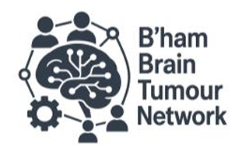


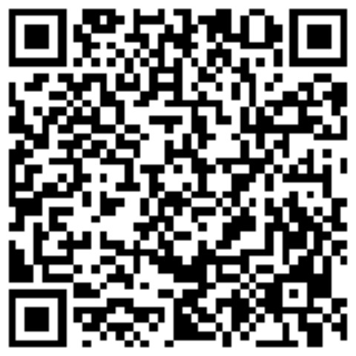
Acknowledgements
Beggs Lab, Genomics Research Team – UoB:
Prof Andrew Beggs
Dr Jo Stockton
Dr Anetta Ptasinska
Nick Tovey
Elena Efstathiou
Kaitlin Marley
Brain LRS Team – UoB / UHB:
Miss Victoria Wykes
Dr Vassili Crispi
Kathryn Charles
Sahar Sanai
Lisa James
Genomics Research – WMRGL:
Dr Hannah Titheradge
Dr Amy Gerrish
Lorraine Hartles-Spencer
Sam Court
Contact via email:
l.r.ames@bham.ac.uk
Follow me on LinkedIn:

